Slide 1
Science behind use of
Antenatal Corticosteroids, CPAP and Surfactant

Slide 2
What shall we learn?
How do Antenatal steroids(ANS) work?
How does CPAP work?
How does Surfactant work?
Synergistic action of ANS, CPAP and surfactant

Slide 3
Quantum of Prematurity
India
  highest number of preterm births and
  Highest number neonatal deaths due to prematurity
Births - 2.6 crore live births/year
Preterm births - 35 lakh/year
Preterm deaths - 3 lakh babies (10%)

Slide 4
Vulnerability in Prematurity
Fetal lung immaturity - principal contributor for neonatal mortality
Primary focus of strategies to improve the survival - Lung
Strategy for prevention and treatment of RDS
  Acceleration of fetal lung maturation by ANS therapy to the mother
  CPAP to the neonate
  Surfactant to neonate

Slide 5
How do Antenatal Steroids Work?
Accelerate development of pneumocytes, improve lung mechanics (maximal lung volume, compliance), gas exchange
Increases surfactant production
Induction of surfactant release, absorption of alveolar fluid, increase lung antioxidant enzymes
Reduction in RDS, Reduction in Intraventricular hemorrhage, Necrotising enterocolitis, systemic sepsis and mortality.

Slide 6
What is CPAP?
CPAP – Continuous positive airway pressure
Application of continuous pressure during both inspiration and expiration in a spontaneously breathing baby

Slide 7
What does CPAP do?
Provides constant airway pressure
  Keeps the alveoli open
  Keeps airways splinted & open (improves FRC)
Leads to
  Better breathing
  Better gas exchange – Less lung injury

Slide 8
How does CPAP work?
Pulmonary
  Increases FRC
  Decreases V/Q mismatch
  Splints upper airway – ↓ airway resistance
  Increased Tidal volume
  Decreased Work of breathing
  Conserves surfactant
  ↑ lung compliance
Notes:
Let us understand how CPAP helps – in a baby with RDS the Functional Residual Capacity of Lung FRC is reduced as alveoli collapse at end of expiration . CPAP increases the FRC decreases the Ventilation Perfusion mismatch thus improving oxygenation , washing out the CO2 , improving the pH .It splints the upper airways preventing obstructive apnea , dilates the lower airways thus reducing the airway resistance . Overall Tidal volume improves and the work of breathing decreases .With improved physiology the pneumocyte 2 which produces surfactant functions better with better recycling and production , this reflects as improved lung compliance in long run .

Slide 9
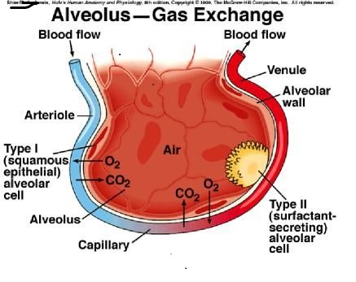
GAS EXCHANGE and FRC

Slide 10
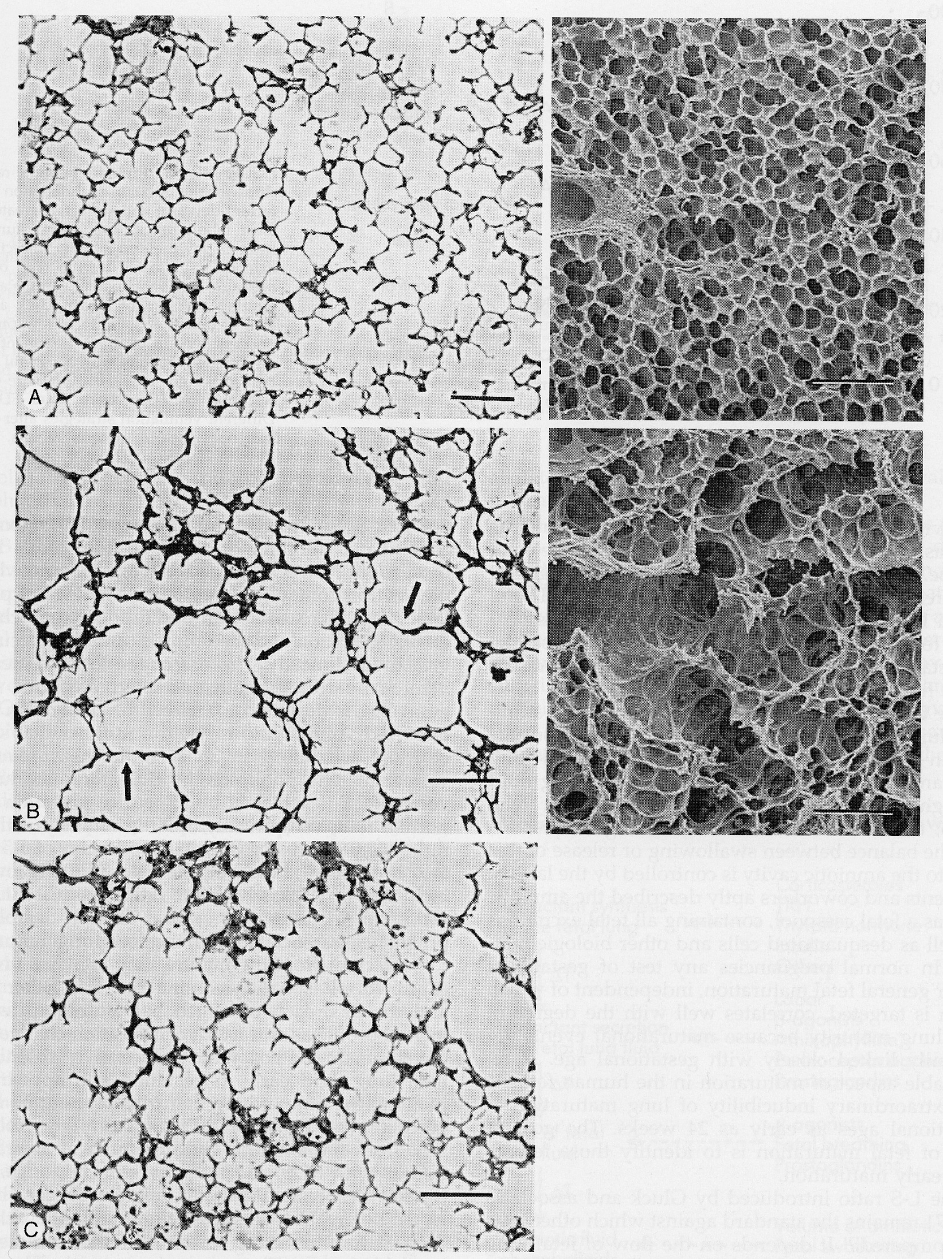
Why not conventional ventilation?
No
Ventilation
24 hrs Ventilation
Limitations of premature lung
Underdeveloped architect to hold the lung open
Thicker and few septa so less surface area for gas exchange
Pinkerton KE, et al J Appl Physiol, 1994
Notes:
Let me share with you the animal experiments which will convince that CPAP is better than conventional ventilation
Here is preterm Lamb lung in which alveolar septa are damaged following 24 hours of ventilation . Though the FRC is increased following ventilation but the effective surface area for gas exchange has decreased. In preterm , the alveolar wall is thin with less supporting tissue , hence more prone to damage

Slide 11
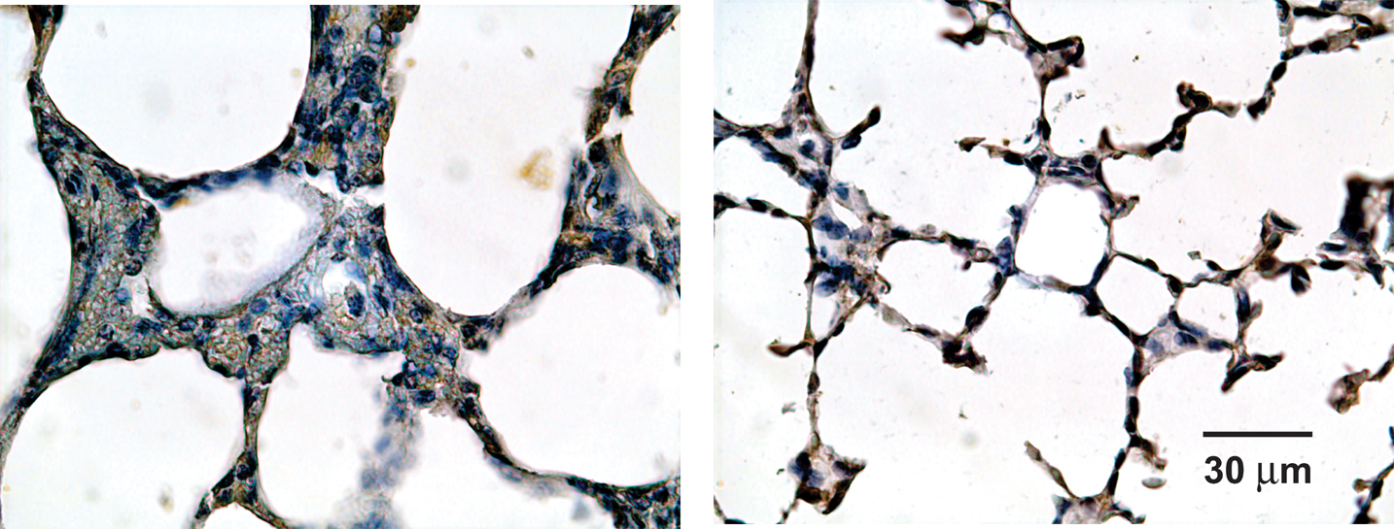
Preterm Lambs at 72 Hours
Distal Airspace Wall Thickness
C V
nCPAP
Notes:
Notice in this preterm lamb , following 72 hours of conventional ventilation the inter alveolar wall thickness is 3 to 4 times when compared with another in which nasal CPAP is given. With thickened alveolar wall the gas exchange will become difficult in preterm

Slide 12
CPAP Magic
No ET tubes- no biotrauma
Opens the lung at FRC – negligible atelecto-trauma
Keeps it open by minimal constant pressure –least baro and volutrauma
Pulmonary arterial pressure are least hence less V/Q mismatch
Notes:
So CPAP is like a Magic .It opens the lung at FRC for better gas exchange keeps the lung open with minimal pressure than in CV
Thus causing less of barotrauma, Baby is breathing spontaneously deciding its Tidal Volume , so no volutrauma but most important as there is no endotracheal tube no biotraunma . Pulmonary arterial pressure are least with improved blood flow , hence less VQ mismatch

Slide 13
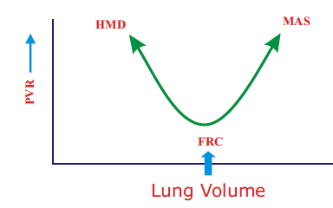
Effect on Pulmonary Vascular Resistance
Optimal CPAP – Keeps lung open at the FRC
PVR is least at FRC

Slide 14
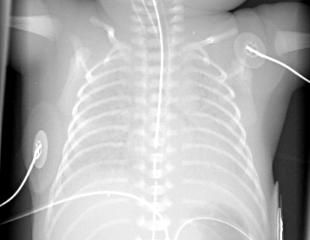
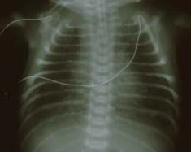
PVR Increases at Lung Volumes Below and Above FRC
PVR
Lung Volume
Notes:
Let us understand the relationship between Lung volume – X axis with Pulmonary vascular resistance – y Axis .
PVR is least once the lung is open at the FRC , at this blood flow is maximum with Best ventilation perfusion matching and gas exchange.
You can see on Right- baby with MAS has higher lung volume while on left HMD has lower lung volume both RESULT in high PVR .
In clinical practice , for a baby on CPAP with higher pressure the lung will over distend while low CPAP will cause reduced FRC – in both PVR will increase causing Rt to left shunt impairing pulmonary blood flow .Thus we must ensure lung is opened at FRC for best blood flow and better gas exchange .

Slide 15
CPAP and Surfactant Together!
Imagine a human chain !!
CPAP
Surfactant
Notes:
Alveoli are lined with water molecules which tend to pull alveoli towards centre – this can be nullified by CPAP pressure or by reducing the ST by giving surfactant . And if both are done simultaneously synergistic action can be obtained . This has gone into clinical practice and called as INSURE .

Slide 16
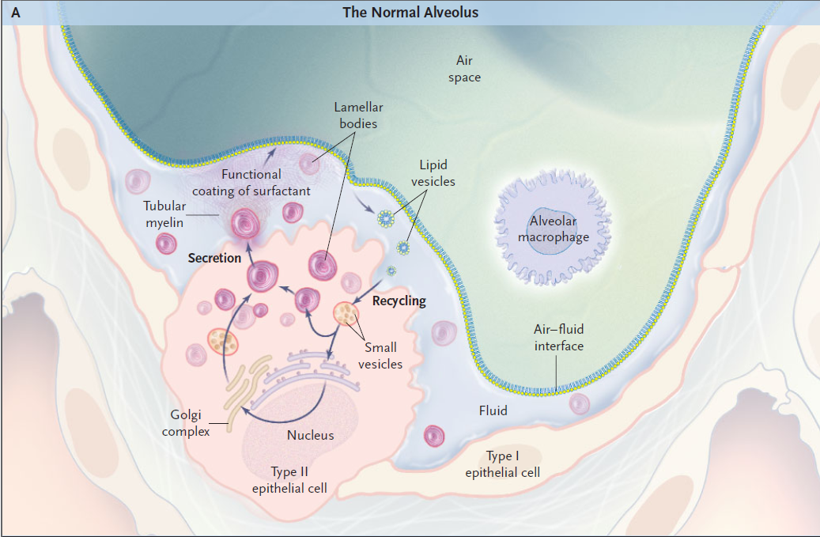
Surfactant production

Slide 17
What did we learn ?
CPAP is safe as it causes less lung injury
Give optimal CPAP to open the lung at FRC as PVR is least with maximum blood flow
Surfactant and CPAP together is beneficial in RDS
CPAP will give maximum dividends if used with antenatal steroids and early surfactant when required
Good delivery room care and use early CPAP
Notes:
We learnt , CPAP is safe as it causes less lung injury . One should give optimal CPAP to open the lung at FRC as pulmonary vascular resistance is least with maximum blood flow. Use of surfactant and CPAP together is beneficial in RDS . It is also very important to understand that CPAP will give maximum dividends if you use antenatal steroids for preterm labor, early surfactant if required and have Good delivery room care and use early CPAP.

